Slide 1

Section 7.8 Improper Integrals
Lecture 2
Case 1: Unbounded in x
Comparison Theorems

Slide 2
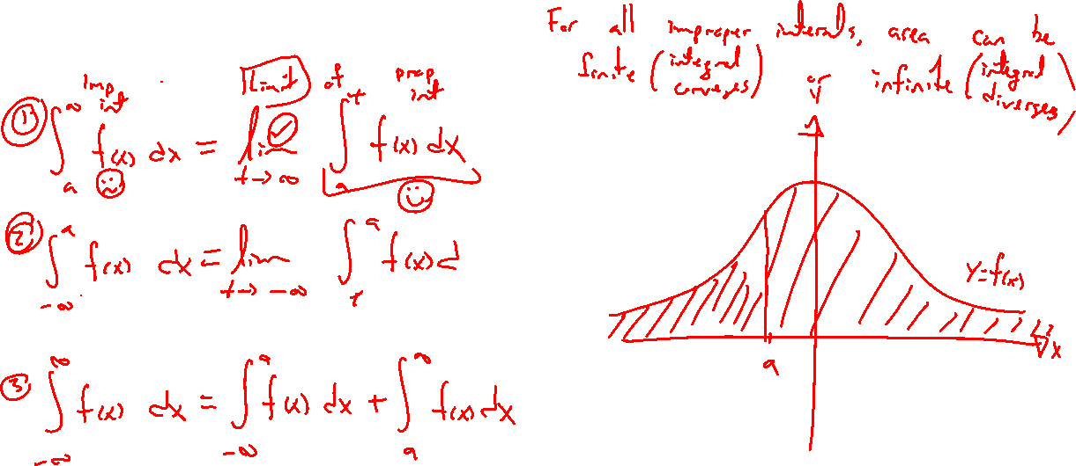
Recap: Unbounded in x
Notes:
Careful limit definitions of each, draw pictures, rate of decay is key
\int_a^\infty f(x) ~dx
\int_{-\infty}^a f(x) ~dx
\int_{-\infty}^\infty f(x) ~dx, need both limits to exist to separate

Slide 3
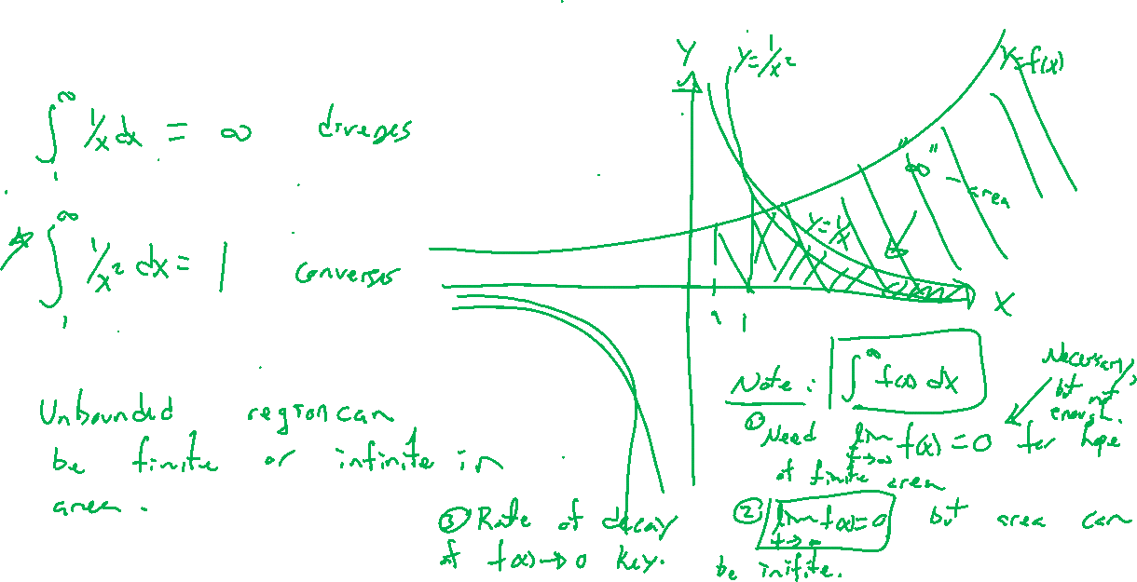
Important Examples
Notes:
\int_1^\infty 1/x dx = \infty
\int_1^\infty 1/x^2 dx = 1
Desmos demonstration

Slide 4

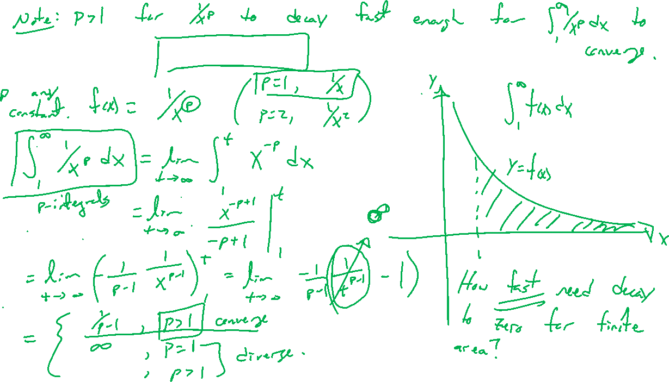
Example: Powers of x and Rates of Decay
Notes:
\int_1^\infty 1/(x^p) dx, p=1 is the barrier for decay rate

Slide 5
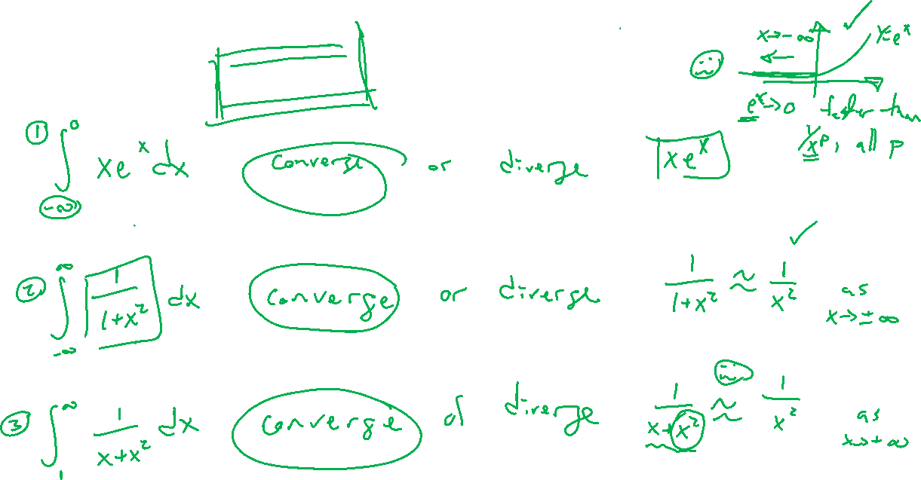
Examples: Intuition and Try on Own
Notes:
\int_{-\infty}^0 xe^x ~dx
\int_{-\infty}^\infty 1/(1+x^2) ~dx
\int_1^\infty 1/(x+x^2) ~dx
Guess if converge or diverge based on p-integral result

Slide 6
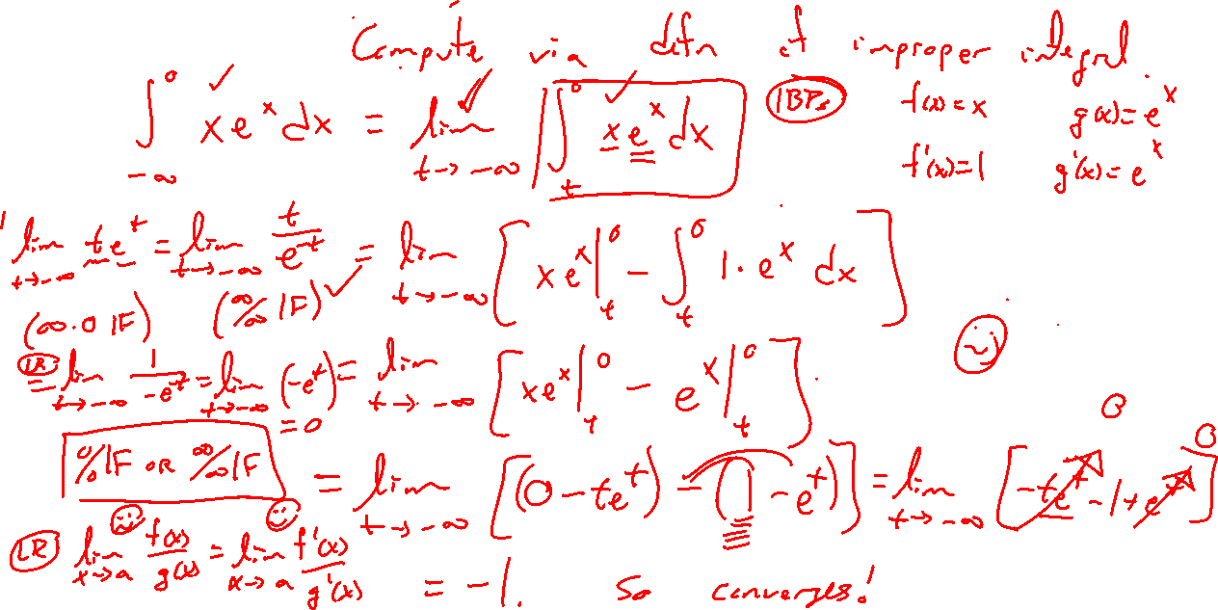
Example:
Notes:
\int_{-\infty}^0 xe^x ~dx

Slide 7
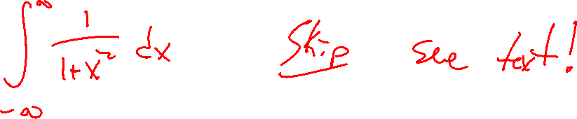
Example:
Notes:
\int_{-\infty}^\infty 1/(1+x^2) ~dx

Slide 8
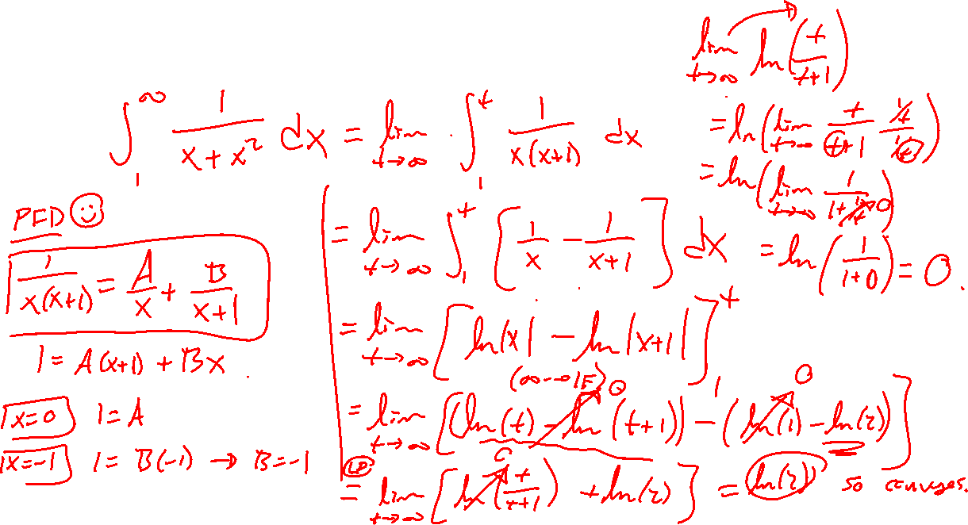
Example: Try on Own
Notes:
\int_1^\infty 1/(x+x^2) ~dx

Slide 9
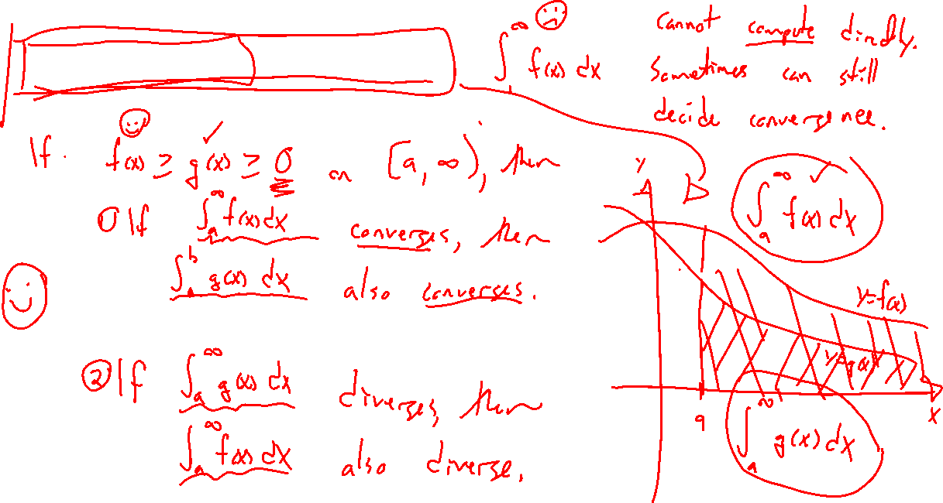
Comparison Theorem
Notes:
If cannot integrate, or don't want to, can compare to something easier to see if converge or diverge.
F(x)>=g(x)>=0 on [a,\infty), draw picture.
Two cases,

Slide 10
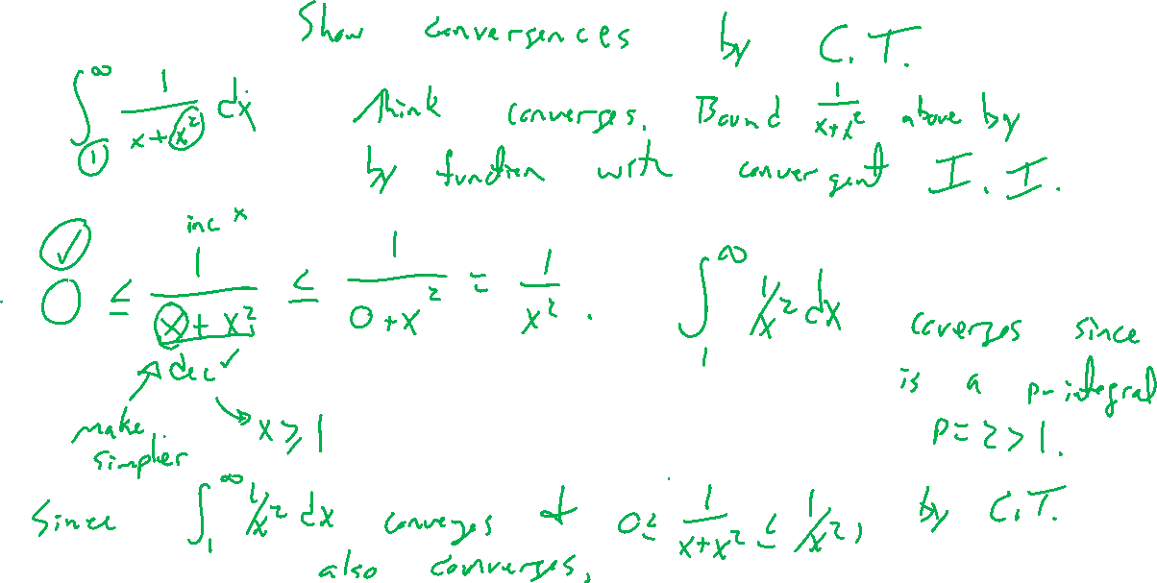
Example:
Notes:
\int_{-\infty}^\infty 1/(1+x^2) ~dx

Slide 11
Example:
Notes:
\int_1^\infty 1/(x+x^2) ~dx

